Slide 1
Review of Correlation Between Goals and Attempt Using FIFA 2018 Data
By Carlos Palomo

Slide 2
FIFA Dataset Variables
The 5 variables that I will be focusing on is "Goal Socred", "Ball Possession %", "Attempts", "Blocked", "Corners"
"Goal Scored" is a discrete numerical variable of the amount of goals the team scored
"Ball Possession" is a discrete numerical variable of the overall amount of time the team had the ball
"Attempts" is a discrete numerical variable of the amount of goals the team attempted scored
"Corners" is a discrete numerical variable of the number of corner shots used
"Blocked" is a discrete numerical variable of number of opponent team's attempts blocked by the team

Slide 3
FIFA Dataset Variables (Historgrams)

Slide 4
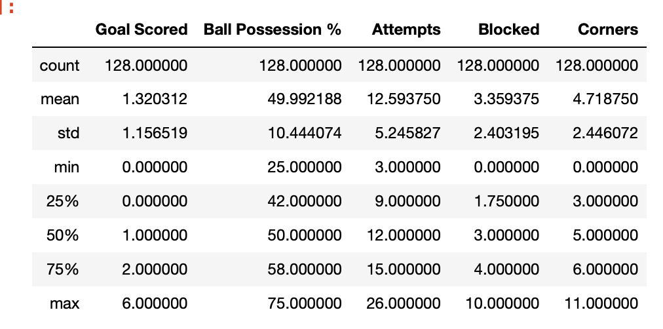
Outliers
Boxplots were used to identify outliers
Outliers were not removed as data as the outliers are not extreme and relate to winning team/Man of the Match

Slide 5
Outliers (BoxPlots)

Slide 6
PMF – Goals for where Man of the Match is True/False

Slide 7
CDF - Goals for Man of the Match
The CDF is step function because goals are discreet values
60% of of Goals made by the Man of the Match was greater than 1
This implies that most goals made are around 1-2 goals

Slide 8
Normal Distribution – Goals Scored
I used a normal distribution do show the distribution of Goal Scored. The graph does not look smooth because the data is not continuous. The reason why this was selected was because looking at the historgram. The data appeared to be distributed in a normal distribution.

Slide 9
Scatterplot – Two Samples of comparing Goals and Attempts

Slide 10
Correlation between Goals and Attempts
Pearson Correlation: 0.14491470805249415
Spearman Correlation: 0.18861425902156578
Based on the Pearson and Spearman Correlation the amount goals and amount of attempts are weakly correlated

Slide 11
Results for Correlation Hypothesis
With a weak correlation I wanted to test to see if there was no correlation between Goals Scored and Attempts.
Null Hypotheses : No correlation between Goals Scored and Attempts
Since the p-value =0.103 we fail to reject the null hypothesis that there is no correlation between Goals Scored and Attempts

Slide 12
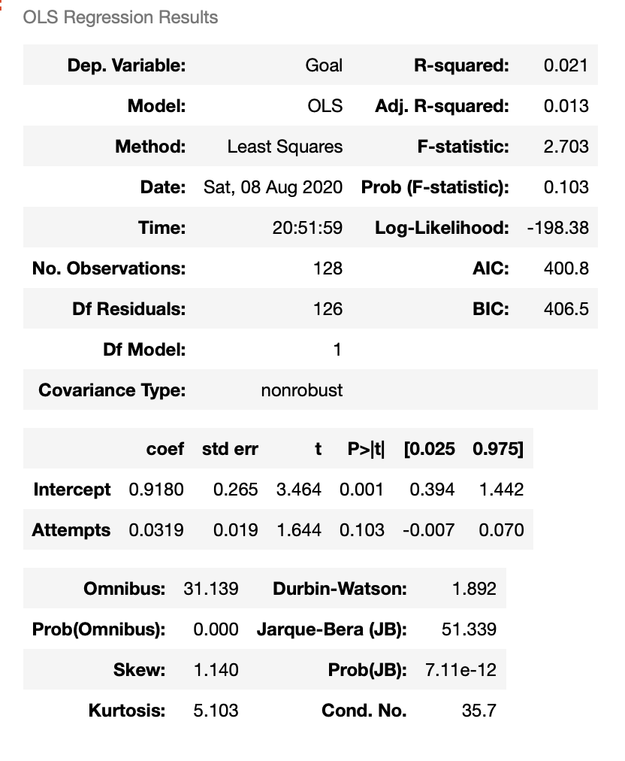
Regression Model to See if Relationship between Goals and Attempts
Based off the summary report from the regression model, the amount tempts does appear to have an effect on the amount goals.

